Slide 1
VETERANS’ ECO-VILLAGE
For Honorably Discharged/Homeless Veterans

Slide 2
Presented by:
Chaplain Lawrence Orvis (Veteran US Army, Chairman Veterans Advisory Board, Chaplain American Legion Post 100)
David M. Boje Ph.D. (Veteran U.S. Army; Regents Professor at NMSU; American Legion Post 10; President Antenarrative Foundation; coordinator of NMSU business student team)
Shannon Reynolds (Veteran Air Force; Coordinator NMSU Engineers Team
Walter F. Baker (Retired Captain, Navy; American Legion Post 10)
Ernest Ramey (Veteran U.S. Army; Veterans Theater President)

Slide 3
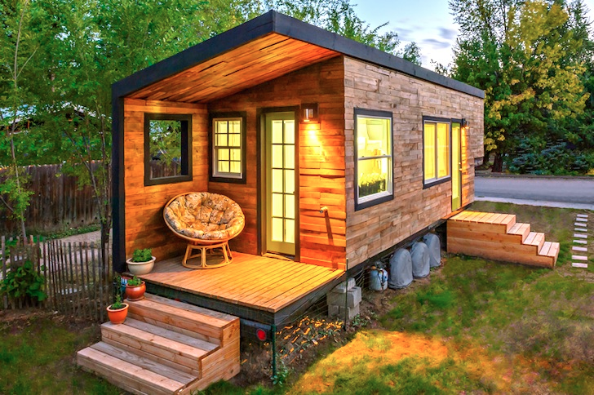
Low Cost NMSU Veterans Village Project Teams
Student Engineers Team: Supervisor – Shannon Reynolds
Jennifer Lopez Nawaf Alkhaldi
Colton Woodruff Paulina Orozco-Barraza
Clay Andrews Robin Leos
Leslie Hathaway Zack Robinson
Mia Brandt Omar Alajmi
Business Students for Sustainability Team:
Supervisor- David M. Boje
Sweata Lal
Samuel Buckingham
Sultan Almajroub

Slide 4
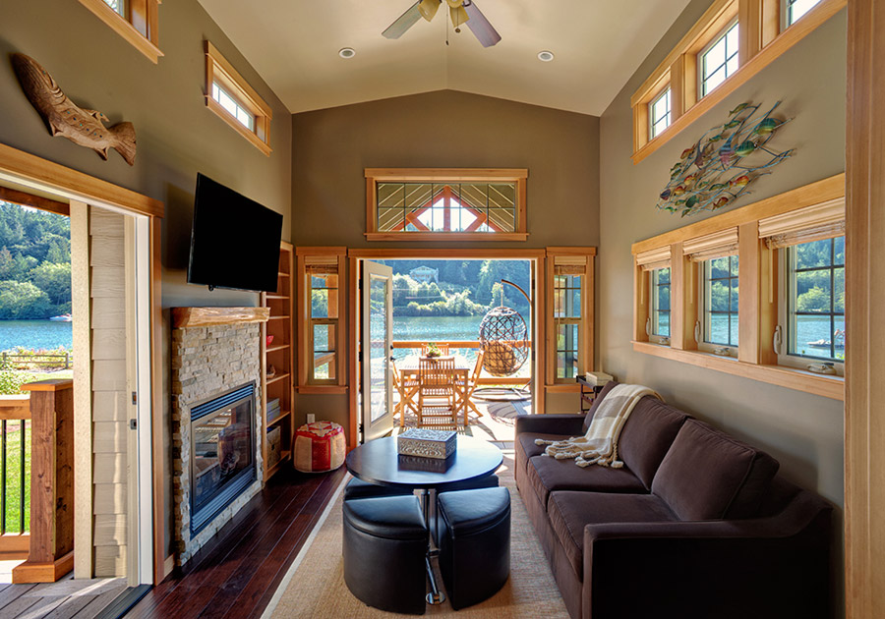
Table of Contents
Executive Summary
Mission Statement
Product Description
Marketing Plan
Market Analysis
Customer Analysis
Competitor Analysis
Financial Projections
Micro-Enterprises Powered by Veterans
Summary

Slide 5
Executive Summary: Our Aim Today
We seek a vote of confidence for our vision: VETERANS’ ECO-VILLAGE
They are not RVs, they are Tiny Homes with Green construction in an ecological village.

Slide 6
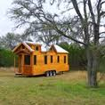
Customer Analysis
78% of Tiny House people own their home, compared to 65% of homeowners of traditional homes.
Average Tiny House is 186 sq/ft while a standard house takes up nearly 2100 sq/ft.
Average cost to build a Tiny House: $23,000
89% of Tiny House people have less credit card debt than the Average American.
55% of Tiny House people have more savings than the average American (i.e average of $10, 972 in the bank).

Slide 7
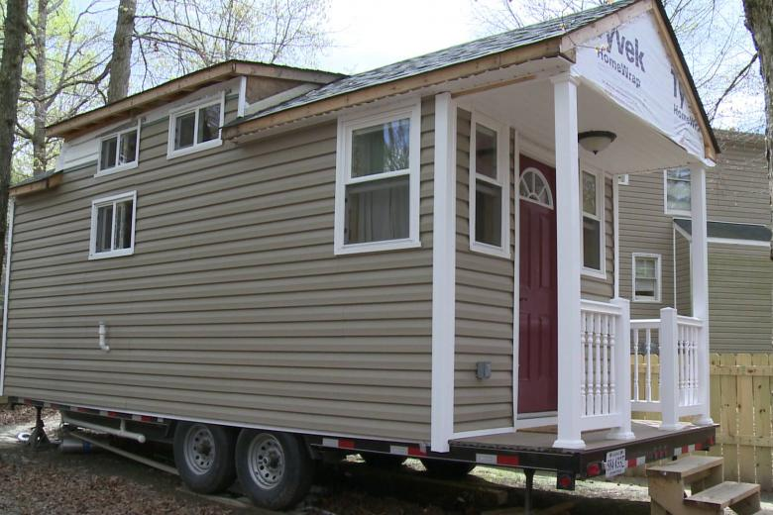
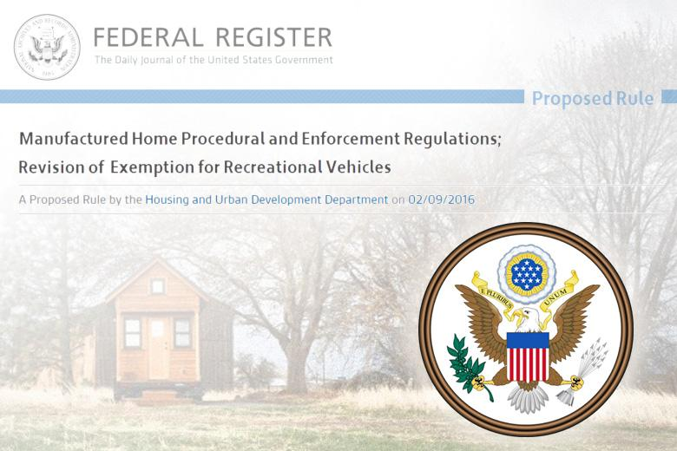
We use HUD codes, NOT RV codes
Definition of a Tiny House - Tiny Houses differ from existing classifications of recreational vehicles, manufactured housing, and homes on permanent foundations.
Notes:
- See more at: http://timbertrails.tv/Government-HUD-Rule-Could-Prohibit-Use-of-Tiny-House-as-Dwelling-Domicile-Primary-Residence#sthash.kqBOzfY0.dpuf

Slide 8
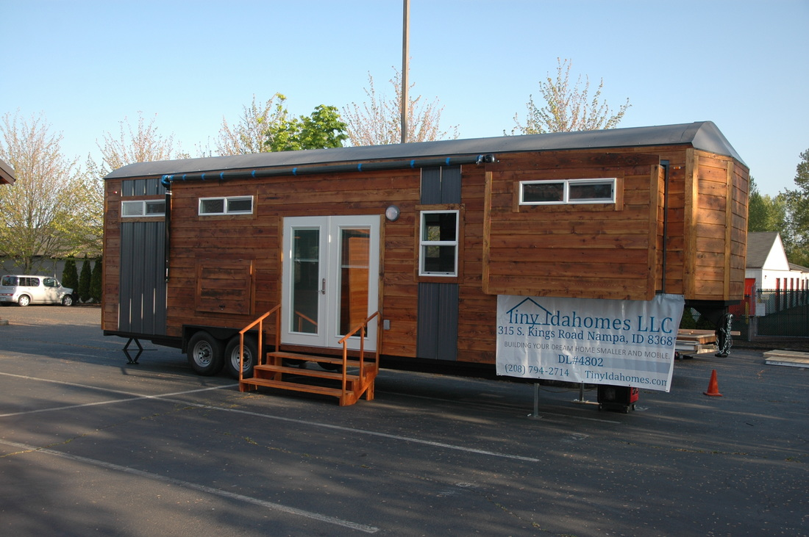
Executive Summary - An Overview of Business Plan
Examples of Portland Tiny Homes
PORTLAND CITY COUNCIL gave a thumbs up to TINY HOUSES VILLAGE for working poor making less than $21K a year
https://www.youtube.com/watch?v=e8hDYN_Herk
https://www.f6s.com/profile/1050640/about

Slide 9
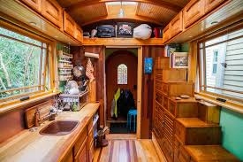
Mission Statement
Sustainable Tiny Homes in ECO-VILLAGE in Las Cruces would be a profitable and low cost investment for local businesses. They would be a valuable alternative for anyone who would like to live simply in a portable sustainable home and become self-reliant.

Slide 10
Vision Statement
Provide a one-of-a-kind cutting-edge facility for military personnel (active and retired/veterans) and their families to strengthen and heal themselves through a continuum of traditional and innovative treatment and interactive opportunities with animals and the environment of Tiny Homes (lease or purchase), RV Tiny Home temporary stays, &/or weekend retreats for post-deployment decompression.

Slide 11
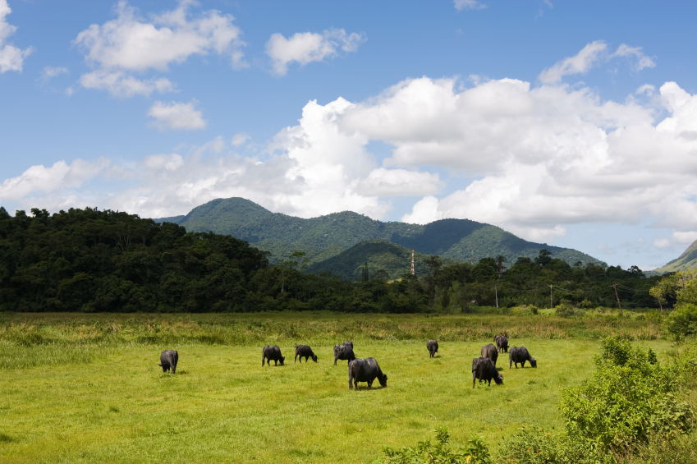
Legacy Ranch: Eco-Village
A Collaboration between NMSU, our Military-Serving Institutions, and our Extended Economic Community.
A Healing Community for our Military and their Families.
A Program of VETERANS THEATER.

Slide 12
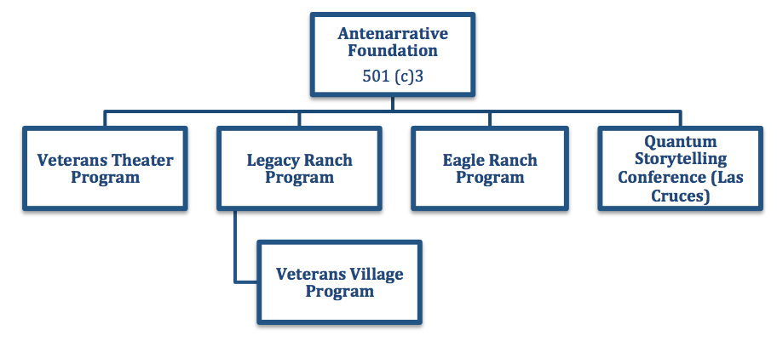
501(c)3 ANTENARRATIVE FOUNDATION
ANTENARRATIVE Foundation Board of Trustees
David M. Boje, (Veteran Army) President & NMSU Regents Professor
(575)-936-9578 (cell) or David@davidboje.com
James Sassak, VP
Nancy Starr Breard, EDD, Treasurer 864-706-4282
Ernest Ramey, Secretary (Veteran Army)
John Hawk, Agent-at-large (Veteran Navy)
Wanda Whittlesey-Jerome MSW Social Work NMSU Professor

Slide 13
COMMUNITY FIRST VILLAGE, AUSTIN TX- 200 Homes
COMMUNITY FIRST - 27 acres, with little cottages and mobile homes dotting the landscape. A three-acre community garden, grocery store, & help services is also on-site.

Slide 14
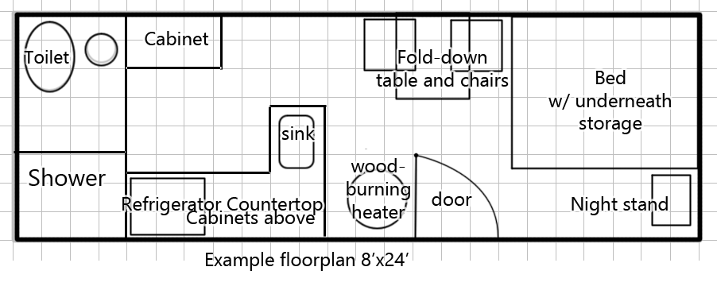
Dimensions and TINY HOME Specifications
Considerations
Permanent Residence
1-2 people and a pet
Fit HUD Regulations
Cost
Truck Specifications
Full-sized truck
15’ rental U-haul
Final size recommendation
8’x18-25’ long

Slide 15
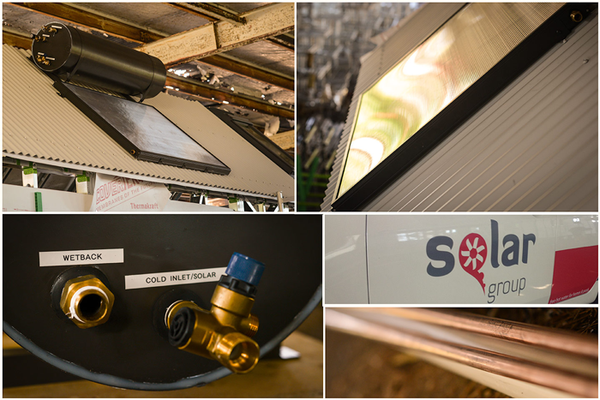
Solar Water Heater
> Installed on the roof of the vehicle / home
> Two categories either direct or indirect system
> Useful in cold weather climatic zone
> Simple to install and doesn’t take a lot of space
https://www.youtube.com/watch?v=D-ZpzDntsZ0

Slide 16
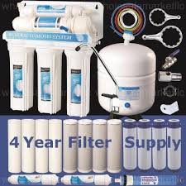
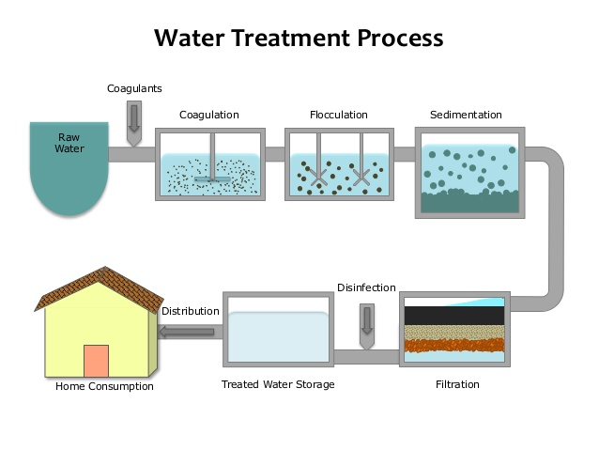
Water Treatment
Stages
-Disinfection
-Coagulation and flocculation
-Sedimentation
-Filtration
Filter systems
- In-line water system
- RO Drinking Water System
Grey water
-Dump
-Other Uses

Slide 17
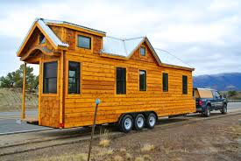
Product Description
Tiny Homes Designs (e.g. Rocky Mountain House Design); there are 3 manufacturers in New Mexico, plus one developing in Las Cruces by Shannon Reynolds and Engineer faculty/student team at NMSU.

Slide 18
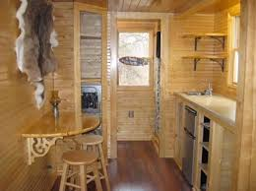
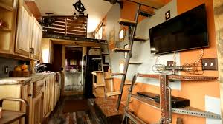
Marketing Plan
Market Analysis
Customer Analysis
Competitor Analysis

Slide 19
Market Analysis
Where to locate Eco-Village in Las Cruces City Limits
- E.g. A city owned or University-owned piece of land, 75 to 150 acres
Lease the land for an Eco-Village for $1 a year
Veterans can rent $20 to $50 a month, or can lease/purchase for $300 to $450 a month (selling price approx. $22,000).

Slide 20
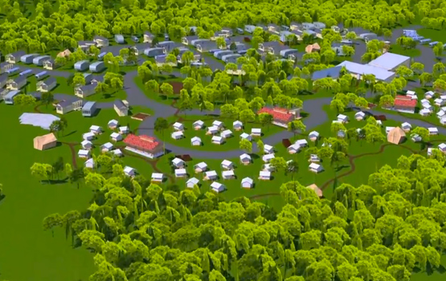
Eco-Village Concept
E.g. Austin TX: Mobile Loaves and Fishes’ Alan Graham, says one reason many in the nearby community are on board is because there will also be a bed and breakfast in the village and an Alamo Drafthouse outdoor movie theater. Graham adds that if 200 chronically homeless people get back on their feet, it could save Central Texas taxpayers about $10 million a year.

Slide 21
Market Analysis (those who gave…)
Local Green Contractors for Tiny Homes Construction
Zia Suns Green Construction Co. LLC
Sun & Earth Inc. (Sun & Earth offers roof coatings, high efficiency cooling, solar heating, and sustainable building).
WDG Architects (Architectural services, Waste reduction and recycling, energy efficient practices and LEED Consulting).
AKS Architecture, P.C. (Full-service architectural firm focused on sustainable design and planning for public and private facilities. Sustainable elements in all projects, including waste recycling requirements, LED lighting, enhanced building insulation, daylighting and geothermal heating and cooling systems).
Earthwise Studio & Earthwise Strategies (Architecture, Engineering and Building Design).
Malooly (Come see us for green products like reclaimed hardwood, renewable cork, carpet made of recycled content, and more. We sell many green products. We try to reduce, reuse, recycle and reclaim).

Slide 22
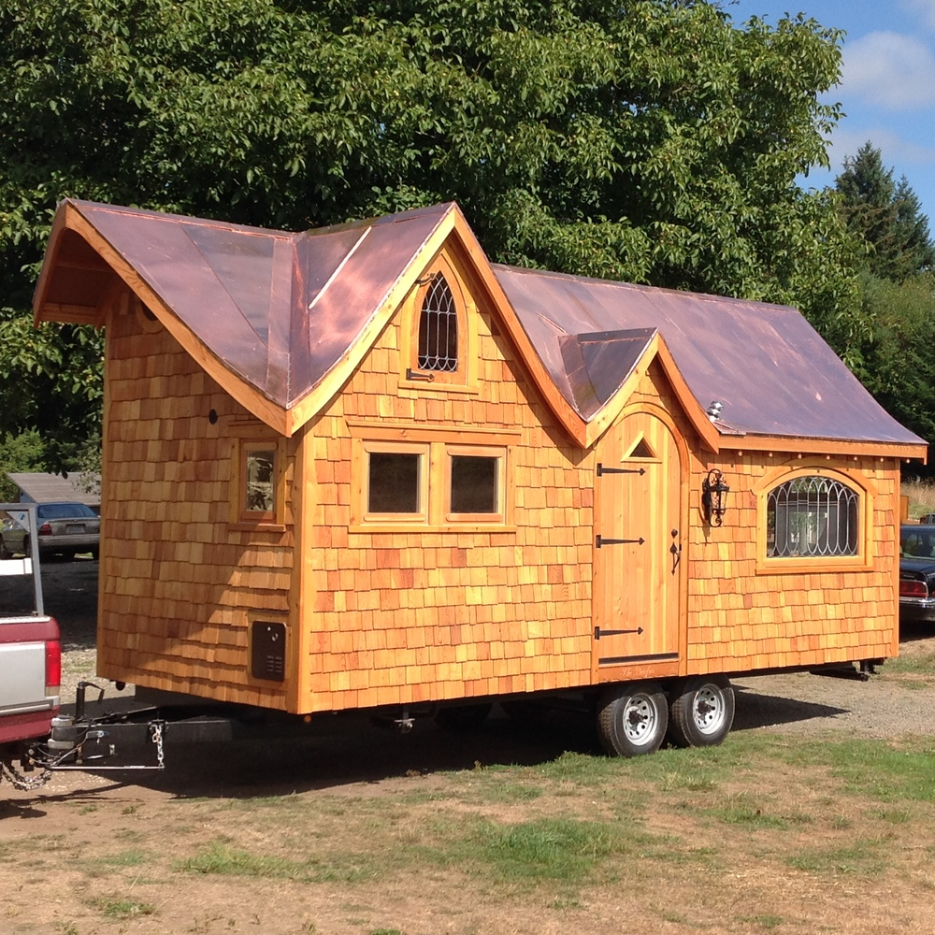
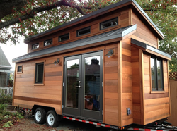
Market Analysis Cont.…
Las Cruces Municipal Codes
Sec. 30-171. - Building permits and manufactured or mobile home installation permits
Sec. 30-172. - Mechanical/plumbing permits
Sec. 30-173. - Electrical permits
Sec. 30-656. - All manufactured and mobile homes require a permit for installation regardless of placement location. The purpose of these requirements is to ensure that manufactured and mobile homes are placed and maintained to provide safety for their residents.
(Ord. No. 2478, § I, 11-17-08)
Zoning : General Zoning Districts
Single-Family Rural Residential Zoning Districts
REM Single-Family Residential Estate Mobile
R-1cM Single-Family Low Density Mobile
R-1aM Single-Family Medium Density Mobile
R-1bM Single-Family High Density Mobile

Slide 23
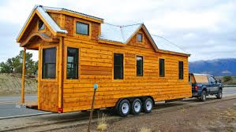
Customer Analysis
Target Market:
Those who seek affordable, simple, and sustainable
housing alternative living in the Las Cruces community
Want to Live Sustainably (Economically and Environmentally)
Seek affordable housing with low utility and energy bills
Own homes rather than renting
Simple lifestyle/ Less upkeep
68% of Tiny House people have no mortgage, compared to 29.3% of all US Homeowners

Slide 24
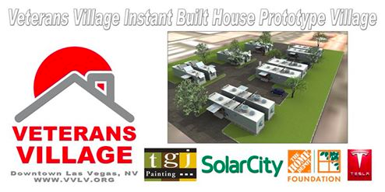
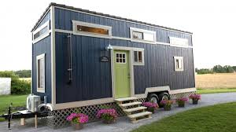
Competitor Analysis
Traditional Mobile Homes
- More Spacious
- Affordable housing
- More established market
- Larger variety to choose from

Slide 25
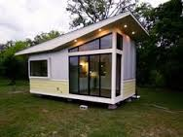
Financial Projections
Build and Sell 20 Tiny Homes, on wheels, in 2016, average price $27,000
Build and Sell 40 Tiny Homes, on wheels, in 2017, average price $33,000
Build and Sell 60 Tiny Homes, on wheels, in 2016, average price $33,000
 | Year 2016 | Year 2017 | Year 2018 | Year 2019 | Year 2020
Number in Production | 20 | 40 | 60 | 100 | 150
Average Price | 27000 | 33000 | 33000 | 31000 | 30000
INCOME | 540000 | 1320000 | 1980000 | 3100000 | 4500000
Materials & Labor | 38000 | 71000 | 96000 | 152000 | 260000
Taxes | 10000 | 20000 | 30000 | 50000 | 70000
COST TOTAL | 48000 | 91000 | 126000 | 152037 | 330000
NET Profit Projected | 492000 | 1229000 | 1854000 | 2947963 | 4170000

Slide 27
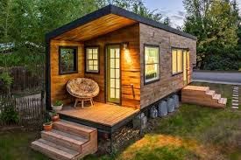
MICRO-ENTERPRISES POWERED BY VETERANS
Micro-Enterprises, such as E-Bay Store, Machine Shop, Carpentry, Organic Farming, and so on.
Micro-enterprises have one to five persons doing business
What about microenterprise constructing Tiny Homes on wheels using sustainable construction practices?

Slide 28
Vision/Summary
Customize each Tiny Home to customer preferences for exterior and interior design
Price Range 23,000 to 33,000 each
Keep homes on wheels
Use Sustainable construction materials
Has advantage of meeting demand for Tiny Home construction in New Mexico
Has advantage of transitioning existing construction trades to Green Design Principles

Slide 29
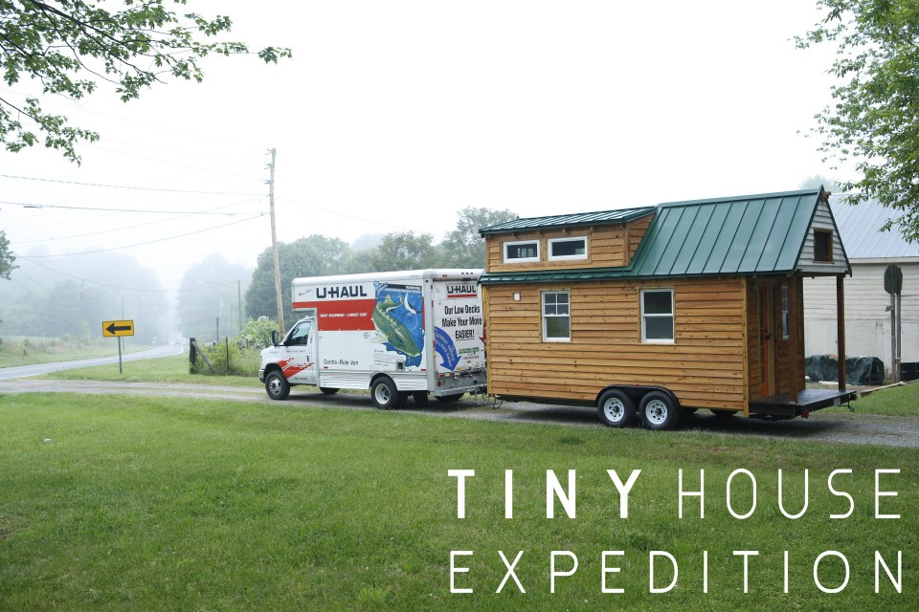
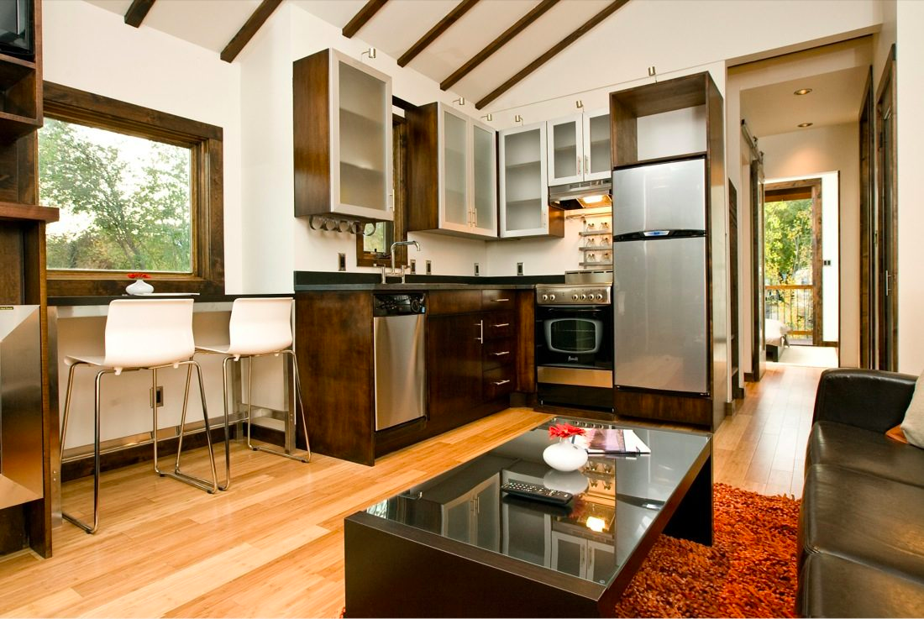
Ladies and Gentleman, Thank you for your time today! We seek your vote of confidence on this initiative and hope that you will take it into consideration and support it. Contact David@davidboje.com

